Slide 1
Scaling Using the Kubernetes Python Client

Slide 2
Assuming you have followed the previous ppt, delete the airmiles deployment and the airmiles2 deployment.
kubectl delete -n default deployment airmiles && kubectl delete -n default deployment airmiles2

Slide 3
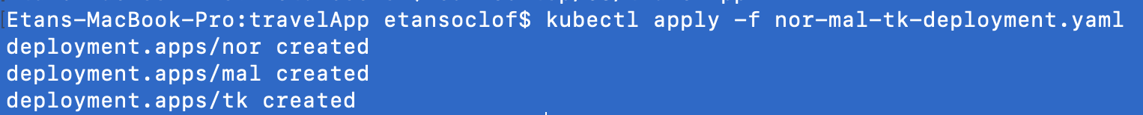
Deploy Nor, Mal, and tk services
These services are all identical to airmiles services.

Slide 4
Kubernetes Client
There is a Kubernetes client for python:
https://github.com/kubernetes-client/python
This library essentially does anything that can be done using kubectl in python code. It accesses the Kubernetes api directly.
See this Kubernetes python client demo:
https://www.youtube.com/watch?v=84Vbzmq3iWs&t=4s

Slide 5
First we import the Kubernetes client.
The configuration (config.load_kube_config())provides access to the Kubernetes API. Then we instantiate the api variable to the Kubernetes api that contains our deployments (AppsV1).
Note: We are using the code external to the Kubernetes cluster. If we wanted to run this code on a Kubernetes pod, we would substitute config.load_kube_config() with config.load_incluster_config() (https://storeofbhor.wordpress.com/2018/04/27/spawning-kubernetes-pods-from-another-pod-using-python-client/)
from __future__ import print_function from kubernetes import config, client from kubernetes.client.rest import ApiException import operator as op from functools import reduce import math config.load_kube_config() api = client.AppsV1Api() namespace = 'default' # str | object name and auth scope, such as for teams and projects

Slide 6
The scale method works by patching the Kubernetes API (via a post http request). It will replace the current spec value with the value given as an argument.
def scale(name, amount): body = {"spec":{"replicas":amount}} try: api.patch_namespaced_deployment(name, namespace, body) print(name + " service scaled to " + str(amount)) except ApiException as e: print("Exception when calling AppsV1Api->patch_namespaced_deployment: %s\n" % e)

Slide 7
The getReplicas() method does not change the API – it only reads from it. The read_namespaced_deployment() function returns a V1Deployment object. This object has functions to access the various parts of object. spec.replicas returns an integer value of the amount of replicas of the given deployment.
def getReplicas(name): try: replicas = api.read_namespaced_deployment(name, namespace).spec.replicas return replicas except ApiException as e: print("Exception when calling AppsV1Api->read_namespaced_deployment: %s\n" % e)

Slide 8
def ncr(n, r): r = min(r, n-r) numer = reduce(op.mul, range(n, n-r, -1), 1) denom = reduce(op.mul, range(1, r+1), 1) return numer // denom def prob_kill(total, normal, tCheck): return 1-ncr(normal,tCheck)/ncr(total,tCheck) def deltaT(pre_deltaT, a, b, prob): return pre_deltaT*((a*prob-b)*(a*prob-b)+1) def deltaT_exp(pre_deltaT, a, prob): #a = 2.718281/(math.sqrt(2.718281)-1) #b = -1/(math.sqrt(2.718281)-1) if prob < 0.5: return pre_deltaT*(math.pow(a, -prob+0.5)) else: return pre_deltaT*(math.pow(a, prob-0.5)) #while True: #if getReplicas("mal") > 0: #print(1-ncr(10000,200)/ncr(10092,200)) # Initial dT0 = 2 # 5 (org), 2(best1) nTK = 2 nMal = 5 #600 normal = 10 total = nMal + normal nCheck = 10 #200 d = 5 a = 6 b = 3 temp_list = [] prob_temp_list = [] stage_list = [] prob_list = [] dT_list = [] nTK_list = [] Nkilled_list = [] nMal_list = [] for i in range(1, 1000): prob_temp_list.append(i/1000) temp_list.append(deltaT_exp(dT0, d, i/1000)) #temp_list.append(deltaT(dT0, a, b, i/1000)) for i in range(1, 100): stage_list.append(i) prob = prob_kill(total, normal, nCheck) prob_list.append(prob) if i == 1: dT = dT0 else: dT = deltaT_exp(dT0, d, prob) #dT = deltaT(dT0, a, b, prob) dT_list.append(dT) nTK = dT * prob * nTK nTK_list.append(nTK) Nkilled = prob * nTK Nkilled_list.append(Nkilled) nMal = nMal - Nkilled total = round(nMal + normal) print("probability=", prob, ", dT=", dT, ", nTK=", round(nTK), ", N_killed=", round(Nkilled), ", nMal=", round(nMal)) #If the amount of tk ms is not equal to nTK, then scale to nTK #if getReplicas("tk") != round(nTK): scale("tk", round(nTK)) if round(nMal) <= 0: nMal_list.append(0) scale("mal", 0) break else: nMal_list.append(nMal) #If the amount of mal ms is not equal to nmal, then scale to nMal #if getReplicas("mal") != round(nMal): scale("mal", round(nMal))
In this code, a number of calculation are made to scale the microservices. Each time a service must be scaled, we simply call the scale() function, providing the name of the microservice we want to scale, and amount by which we want to scale it (highlighted at the bottom of the code)

Slide 9
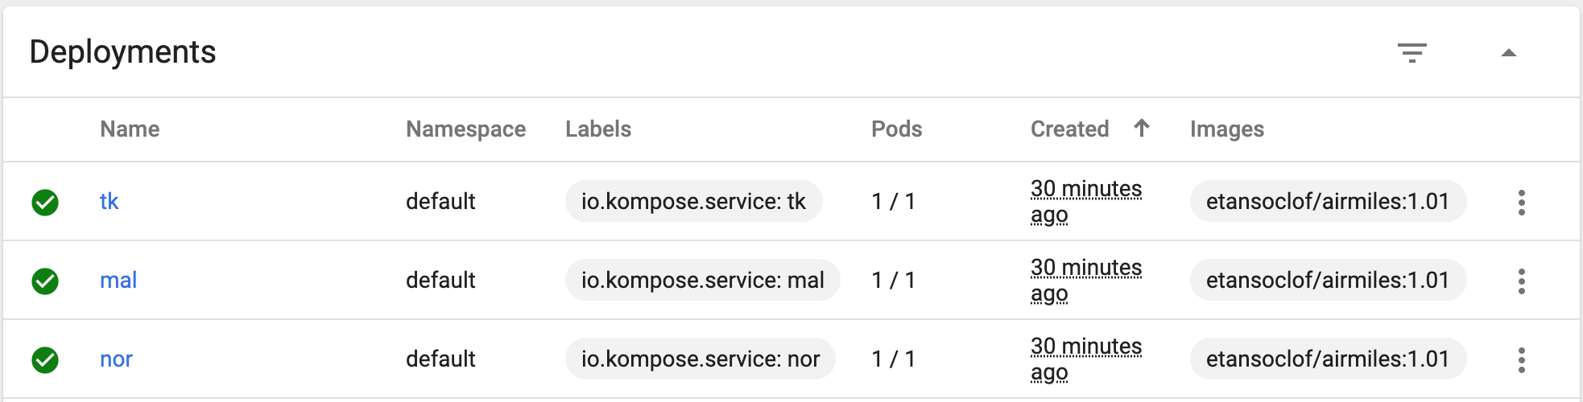
Before running the code

Slide 10
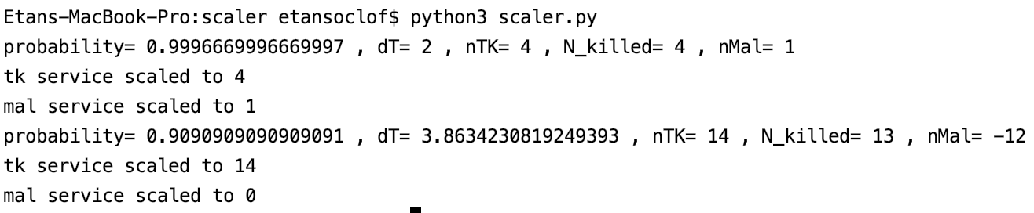
Running the code

Slide 11
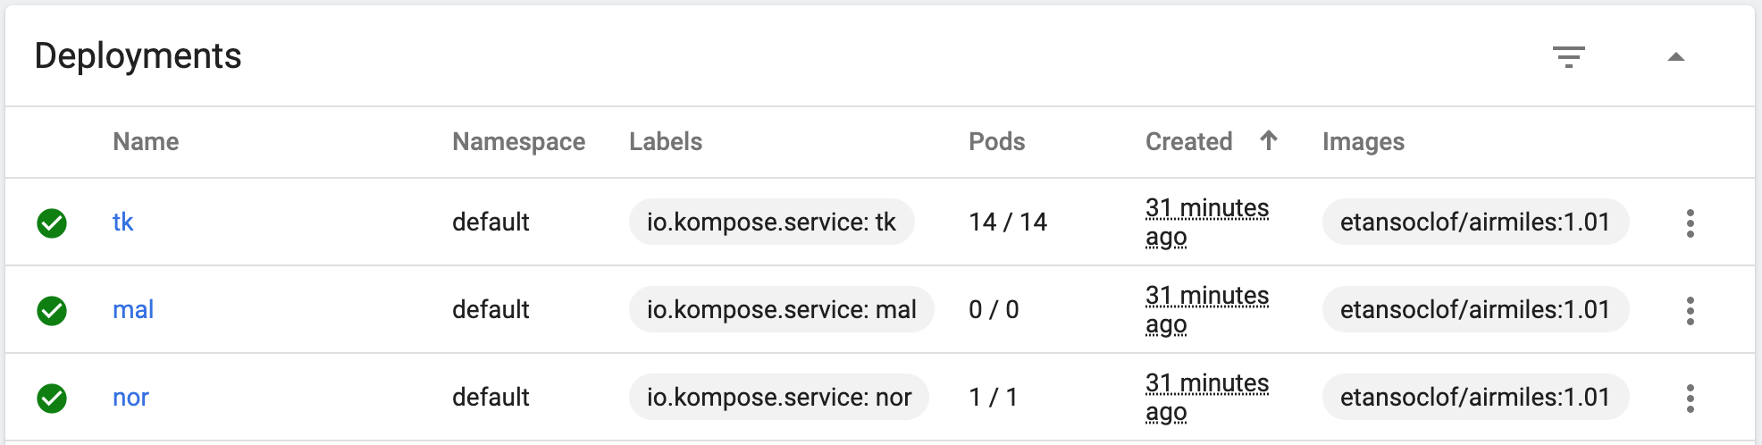
After running the code

Slide 12
Experiment 1 - Copying multiple te.py to LN Service and Running

Slide 13
Deploy PVC
First deploy a persistent volume claim. This will serve as a shared directory between all of the deployments.
Kubectl apply –f shared-directory.yaml
apiVersion: v1 kind: PersistentVolumeClaim metadata: name: shared-directory spec: accessModes: - ReadWriteOnce resources: requests: storage: 1Gi

Slide 14
Deploy bm, bk, and ln deployments
Kubectl apply –f bk-bm-ln.yaml
The bm service contains the code to train the models.
The bk service contains the te.py code which will use the trained models and process the test data.
Ln contains the test data
Note that each of the services mount the shared directory persistent volume.
kind: Deployment apiVersion: apps/v1 metadata: name: bk namespace: default labels: app: bk spec: replicas: 1 selector: matchLabels: app: bk template: metadata: labels: app: bk spec: containers: - name: bk image: 'etansoclof/bk-bm-kubectl:1.01' command: ['sh', '-c', 'echo Container 1 is Running ; sleep 3600'] ports: - containerPort: 5000 protocol: TCP volumeMounts: - name: shared-directory mountPath: /notebooks/shared volumes: - name: shared-directory persistentVolumeClaim: claimName: shared-directory restartPolicy: Always --- kind: Deployment apiVersion: apps/v1 metadata: name: bm namespace: default labels: app: bm spec: replicas: 1 selector: matchLabels: app: bm template: metadata: labels: app: bm spec: containers: - name: bm image: 'etansoclof/bk-bm-kubectl:1.01' command: - sh - '-c' - echo Container 1 running ; sleep 3600 ports: - containerPort: 6006 protocol: TCP volumeMounts: - name: shared-directory mountPath: /notebooks/shared volumes: - name: shared-directory persistentVolumeClaim: claimName: shared-directory restartPolicy: Always --- kind: Deployment apiVersion: apps/v1 metadata: name: ln namespace: default labels: app: ln spec: replicas: 1 selector: matchLabels: app: ln template: metadata: labels: app: ln spec: containers: - name: ln image: 'etansoclof/ln:1.03' command: - sh - '-c' - echo Container 1 is Running ; sleep 3600 volumeMounts: - name: shared-directory mountPath: /notebooks/shared volumes: - name: shared-directory persistentVolumeClaim: claimName: shared-directory restartPolicy: Always

Slide 15
BM service
import pandas as pd import numpy as np from sklearn.preprocessing import LabelEncoder from sklearn.model_selection import train_test_split from sklearn.preprocessing import Normalizer import warnings warnings.filterwarnings("ignore") from keras.utils import to_categorical from keras.utils import np_utils from keras.models import Sequential from keras.layers import Dense, Dropout, Input,Activation from keras.layers import LSTM,SimpleRNN from keras import optimizers train = pd.read_csv('shared/train.txt', header=None) test = pd.read_csv('shared/test.txt', header=None) # add target column # DoS: 1 else: 0 DoS=['back', 'land', 'neptune', 'pod', 'smurf', 'teardrop'] train['target'] = train.iloc[:,41].apply(lambda x: 1 if x in DoS else 0) test['target'] = test.iloc[:,41].apply(lambda x: 1 if x in DoS else 0) train.drop(columns=[41,42], inplace=True) test.drop(columns=[41,42], inplace=True) categorical = [1,2,3] # categorical data # A LabelEncoder is fit on the train data encoder = LabelEncoder() for col in categorical: train.iloc[:,col] = pd.Series(encoder.fit_transform(train.iloc[:,col])) test.iloc[:,col] = pd.Series(encoder.transform(test.iloc[:,col])) X = train.drop(columns='target',axis=1) y = train.target X_train,X_test,y_train,y_test = train_test_split(X,y,test_size=0.2,random_state=10) train.head() X_train.shape #size of parameters batch_size = 128 num_classes = 1 epochs = 5 filter_size=1 #noise = 1 droprate=0.50 y_train = np.array(y_train) y_test = np.array(y_test) X_train = np.array(X_train) X_test = np.array(X_test) #reshape data X_train = np.reshape(X_train, (X_train.shape[0], X_train.shape[1], 1)) X_test = np.reshape(X_test, (X_test.shape[0], X_test.shape[1], 1)) print('train shape after reshape: {}'.format(X_train.shape)) print('test shape after reshape: {}'.format(X_test.shape)) X_train = X_train[:10000] y_train = y_train[:10000] #val X_val,X_test,y_val,y_test = train_test_split(X_test,y_test,test_size=0.5,random_state=10) X_val.shape from keras.layers import Flatten model = Sequential() model.add(LSTM(256, input_shape=(41,1),return_sequences=True)) #model.add(TimeDistributed(Dense(1))) #model.add(AveragePooling1D()) model.add(Flatten()) model.add(Dense(1, activation='sigmoid')) model.summary() from keras import metrics sgd = optimizers.SGD(lr=0.01) model.compile(loss='binary_crossentropy',optimizer='rmsprop', metrics=['accuracy']) X_train.shape history = model.fit(X_train, y_train, batch_size=batch_size, epochs=epochs, #verbose=1, validation_data=(X_val, y_val), #validation_data=(X_test, y_test), shuffle=True) result = model.evaluate(X_test, y_test, verbose=0) #result = model.evaluate(X_test, y_test, verbose=0) result pred = model.predict(X_test) pred.shape from keras.models import load_model from keras.layers import Dense, Activation model.save('shared/DoS_attacks_model.hdf5')
This code trains the models and saves the trained model to the shared directory

Slide 16
Bk Service
from keras.models import load_model import numpy as np import pandas as pd from sklearn.preprocessing import LabelEncoder from sklearn.model_selection import train_test_split from sklearn.preprocessing import Normalizer from keras.models import Sequential from keras.layers import Dense, Dropout, Flatten, Activation, Lambda from keras.layers import Conv1D, MaxPooling1D, BatchNormalization from keras.layers.noise import GaussianNoise from keras import callbacks from keras.callbacks import CSVLogger from keras.utils import to_categorical from keras.callbacks import ModelCheckpoint, EarlyStopping, ReduceLROnPlateau, CSVLogger import pandas as pd import numpy as np from sklearn.preprocessing import LabelEncoder from sklearn.model_selection import train_test_split from sklearn.preprocessing import Normalizer import warnings warnings.filterwarnings("ignore") from keras.utils import to_categorical from keras.utils import np_utils from keras.models import Sequential from keras.layers import Dense, Dropout, Input,Activation from keras.layers import LSTM,SimpleRNN from keras import optimizers from keras.layers import Flatten from keras import metrics import timeit import argparse parser = argparse.ArgumentParser() parser.add_argument("num", help="Input pod number to correspond to correct test.txt number") args = parser.parse_args() file_name = "test" + args.num + ".txt" test = pd.read_csv(file_name, header=None) # add target column # normal: 0 else: 1 #train['target'] = train.iloc[:,41].apply(lambda x: 0 if x == 'normal' else 1) test['target'] = test.iloc[:,41].apply(lambda x: 0 if x == 'normal' else 1) #train.drop(columns=[41,42], inplace=True) test.drop(columns=[41,42], inplace=True) categorical = [1,2,3] # categorical data # A LabelEncoder is fit on the train data encoder = LabelEncoder() for col in categorical: #train.iloc[:,col] = pd.Series(encoder.fit_transform(train.iloc[:,col])) test.iloc[:,col] = pd.Series(encoder.fit_transform(test.iloc[:,col])) #X = train.drop(columns='target',axis=1) #y = train.target #X_train,X_test,y_train,y_test = train_test_split(X,y,test_size=0.2,random_state=10) X_test = test.drop(columns='target',axis=1) y_test = test.target #train.head() #X_train.shape #size of parameters ''' batch_size = 128 num_classes = 1 epochs = 5 filter_size=1 #noise = 1 droprate=0.50 ''' #y_train = np.array(y_train) y_test = np.array(y_test) #X_train = np.array(X_train) X_test = np.array(X_test) #reshape data #X_train = np.reshape(X_train, (X_train.shape[0], X_train.shape[1], 1)) X_test = np.reshape(X_test, (X_test.shape[0], X_test.shape[1], 1)) #print('train shape after reshape: {}'.format(X_train.shape)) print('test shape after reshape: {}'.format(X_test.shape)) #X_train = X_train[:10000] #y_train = y_train[:10000] #X_test = X_test[:1000] #y_test = y_test[:1000] #val #X_val,X_test,y_val,y_test = train_test_split(X_test,y_test,test_size=0.5,random_state=10) model = load_model('shared/DoS_attacks_model.hdf5') start = timeit.default_timer() result = model.evaluate(X_test, y_test, verbose=0) stop = timeit.default_timer() result = str(result) + "\nTime: " + str(stop-start) print(result)
The code for the bk service is te.py. It takes an integer argument to determine which test.txt file it will use in the ln service.

Slide 17
LN service
The ln service has a file-splitter to make it convenient to split the test.txt file based on the amount of
Bk services. For example, If there are
4 bk services, then the test.txt file will
be split into 4.
import requests from kubernetes import config, client from kubernetes.client.rest import ApiException config.load_incluster_config() api = client.AppsV1Api() namespace = 'default' def getReplicas(name): try: replicas = api.read_namespaced_deployment(name, namespace).spec.replicas return replicas except ApiException as e: print("Exception when calling AppsV1Api->read_namespaced_deployment: %s\n" % e) my_file = 'test.txt' hold_lines = [] with open(my_file,'r') as text_file: for row in text_file: hold_lines.append(row) num_of_services = getReplicas("bk") num_of_lines = int(len(hold_lines)/num_of_services) counter = 1 left = 0 text="" while counter <= num_of_services: text = "" file_name = "test" + str(counter-1) + ".txt" increment = counter * num_of_lines hold_new_lines = [] #if left < increment: while left < increment: text += hold_lines[left] hold_new_lines.append(hold_lines[left]) left += 1 with open(file_name,'w') as next_file: for row in hold_new_lines: next_file.write(row) #myobj = {'text': text} #r = requests.post('http://bk.default:80', json=myobj) #with open(file_name, 'rb') as f: #r = requests.post('http://bk.default:80', files={'file': f}) #print(r.text) counter += 1

Slide 18
Provide permissions
kubectl create clusterrolebinding serviceaccounts-cluster-admin --clusterrole=cluster-admin --group=system:serviceaccounts

Slide 19
Copy test and train files to shared directory
Kubectl get pods
Use the name of one of the pods to copy the files into the shared directory.
kubectl cp test8000.txt default/bm-6ddf5b478f-s8tzw:/notebooks/shared/test.txt
kubectl cp train.txt default/bm-6ddf5b478f-s8tzw:/notebooks/shared

Slide 20
Train the models
Kubectl get pods
Use the name of the bm pod to run find_DoS_attacks.py
Kubectl exec bm-6ddf5b478f-s8tzw – python2 find_DoS_attacks.py
The trained model (hd5f file) will be saved to the shared directory

Slide 21
experiment.sh
The shell script splits the test.txt file into the amount of files equal to the amount of bk services. It then executes into each of the bk services where the te.py is numbered and then copied into the ln service. Then it runs each of the te.py.
#!/bin/bash #setup NUM=$(kubectl get po -l app=bk --no-headers | wc -l) LN=$(kubectl get pod -l app=ln -o jsonpath="{.items[0].metadata.name}") kubectl exec $LN -- python2 file_splitter.py COUNT=0 while [ $COUNT -lt $NUM ] do BK=$(kubectl get pod -l app=bk -o jsonpath="{.items[$COUNT].metadata.name}") FILE_NAME=te$COUNT.py kubectl exec $BK -- mv te.py $FILE_NAME kubectl exec $BK -- kubectl cp /notebooks/$FILE_NAME default/$LN:/notebooks ((COUNT+=1)) #curl -X POST localhost:5000/upload -F 'file=@data.csv' -i done COUNT=0 while [ $COUNT -lt $NUM ] do kubectl exec $BK -- kubectl exec $LN -- python2 $FILE_NAME $COUNT & ((COUNT+=1)) done

Slide 22
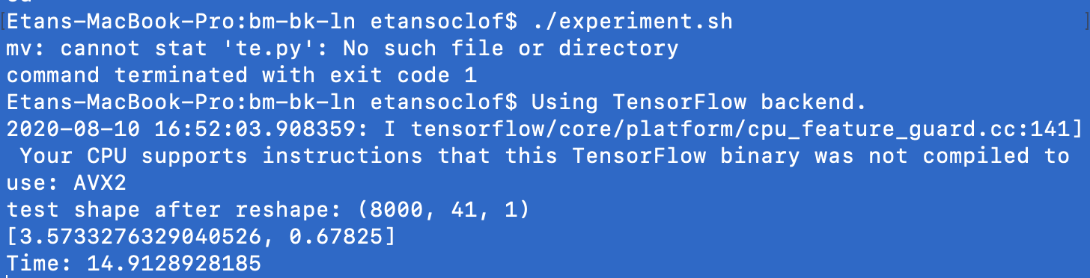
First trial: 1 bk service

Slide 23
Reset and scale
Run the reset shell script. This deletes files created and altered in the previous experiment.
Scale the bk service to 2:

Slide 24
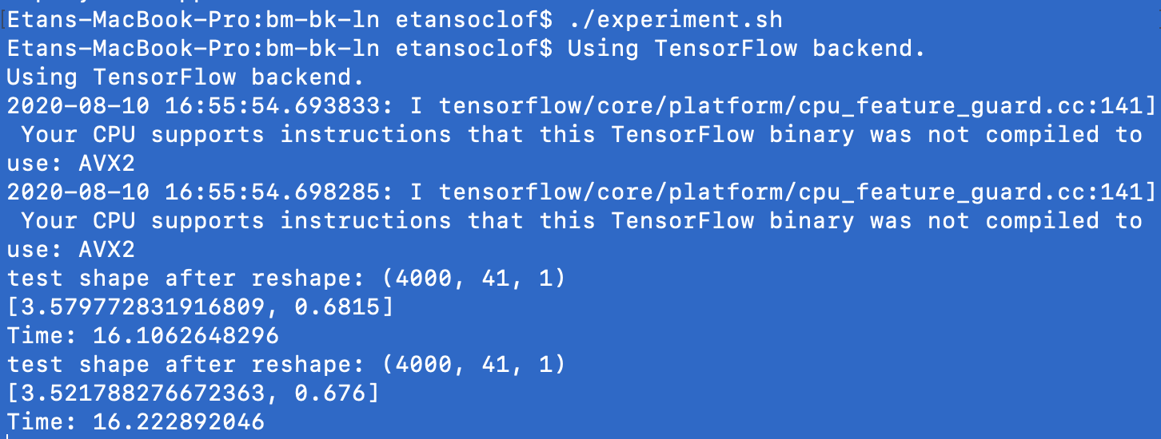
Trial 2: bk = 2
Note that even though there are two te.py running, each only processing half of the test.txt file (4000), it still takes longer than when one is running. This is likely because there are multiple processes running at the same time which slows execution.
Ω

Slide 25
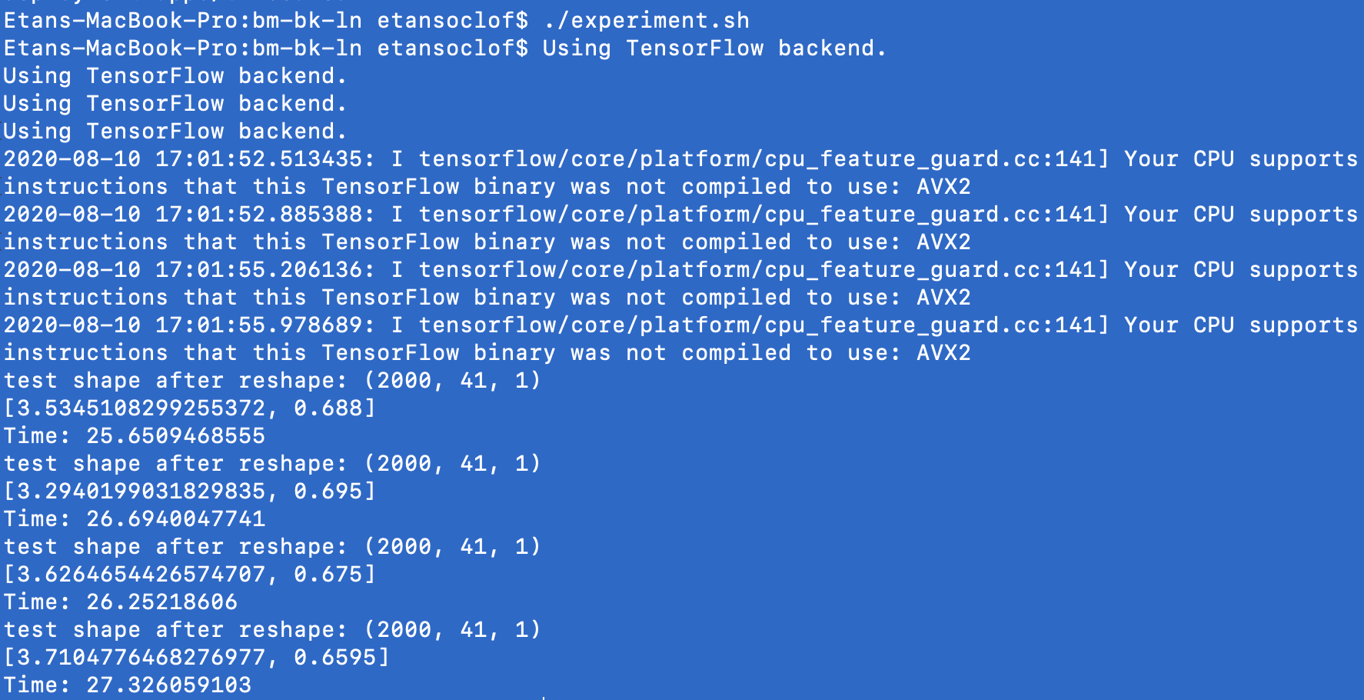
Trial 3: bk = 4

Slide 26
Experiment 2 – Send hdf5 file to te.py Flask application with Threading
Run the te_theano container
This container includes the te.py flask app, the hdf5 file, the test.txt file, and a file-splitter to split the test.txt file
docker run -it -p 5000:5000 etansoclof/te_theno:1.01
/bin/bash
Navigate to notebooks directory
cd ../notebooks

Slide 27
Contents
Te.py flask application. It takes a post http request with an hdf5 file, processes it, and sends back the accuracy and how long it took to process.
Test.txt file
A file_splitter, which splits up the test.txt file

Slide 28
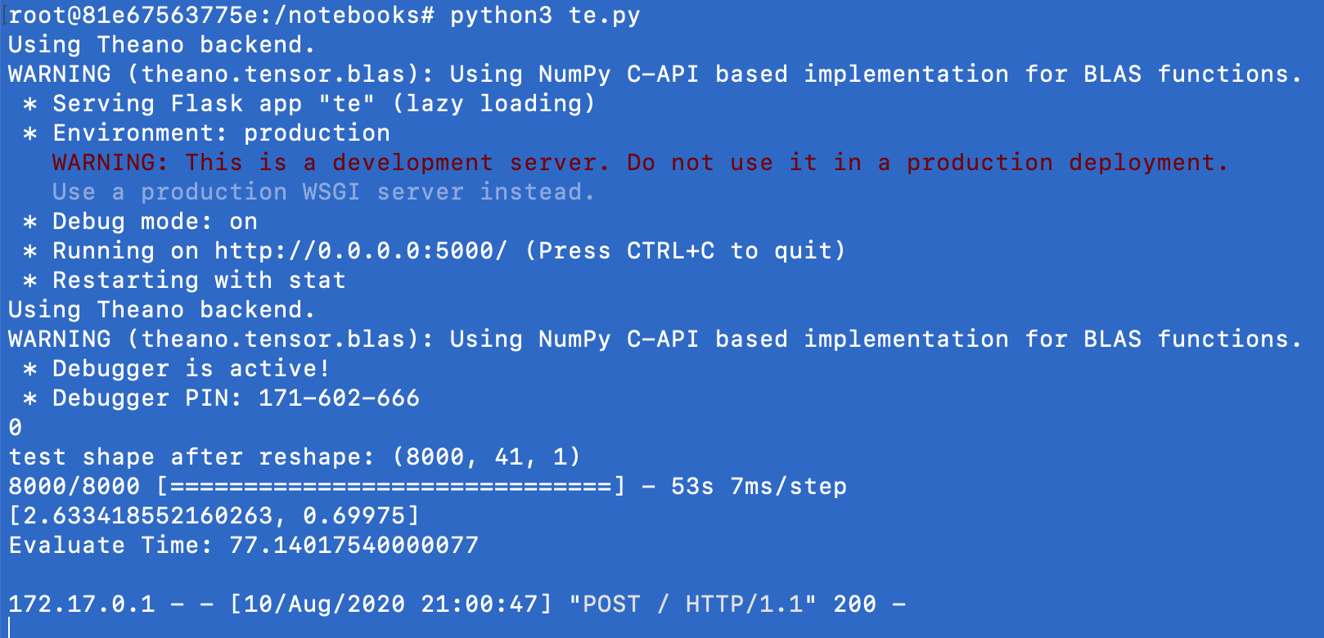
Test 1
Run the te.py flask app inside the container:
Python3 te.py
On the local computer, navigate to the directory with the hdf5 file. Send post request:
curl -X POST localhost:5000/ -F 'file=@Dos_attacks_model.hdf5' -i

Slide 29
Test 2
Run the file_splitter inside the container. This will divide the test.txt file into 2:
Python3 file_splitter.py 2
Restart te.py
Send a single http request (for some reason, if the first thing that you do is send two requests, the app crashes. First send a single requests, wait for it to finish, and then proceed to next step).
Reset by sending a get request:
Curl localhost:5000/reset
Open a second terminal window and send a request from two windows.

Slide 30
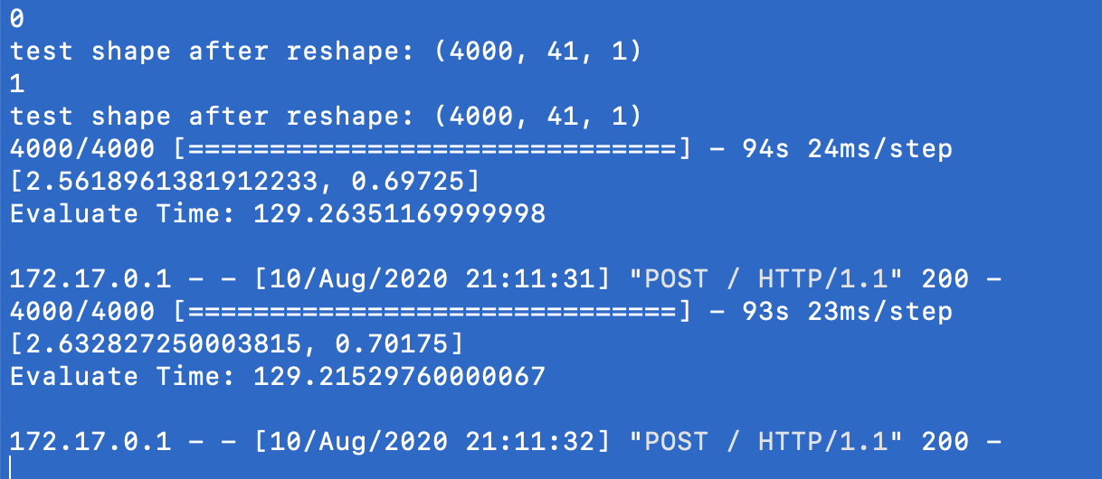
Results

Slide 31
Experiment 3 – Send hdf5 file to te.py Flask application with Multiple processes
Change last line in te.py from:
app.run(host= '0.0.0.0',debug=True, threaded=True)
To:
app.run(host= '0.0.0.0',debug=True, threaded=False, processes=4)

Slide 32
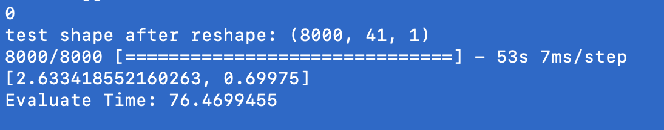
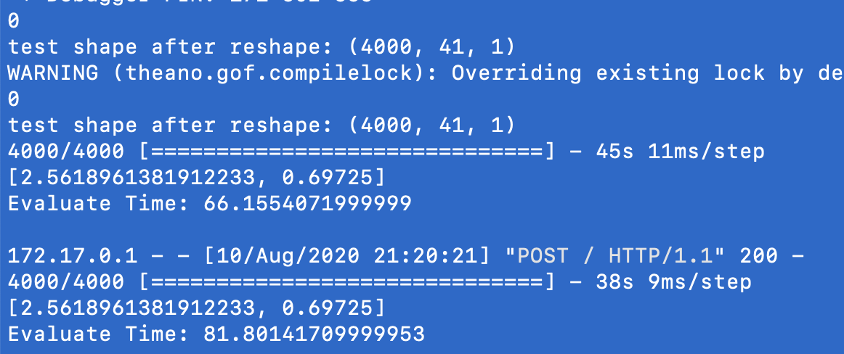
Repeat the above experiment
Single Process:
2 Processes:

Slide 33
Deploying to GKE

Slide 34
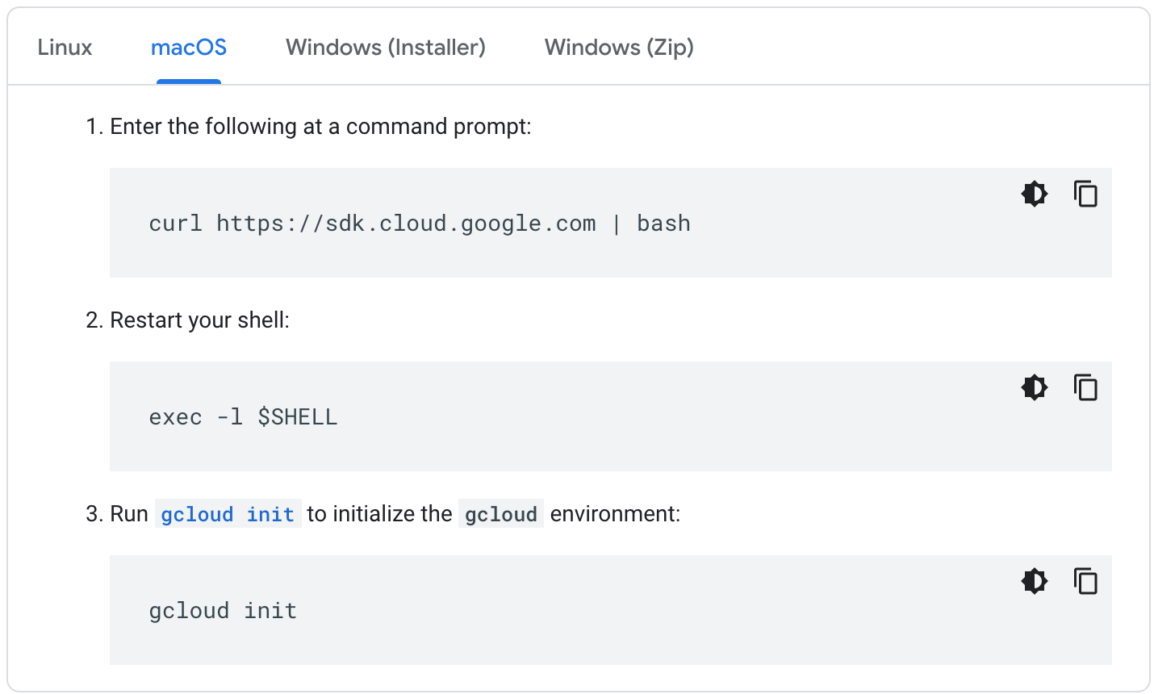
Install gcloud CLI
https://cloud.google.com/sdk/docs/downloads-interactive

Slide 35
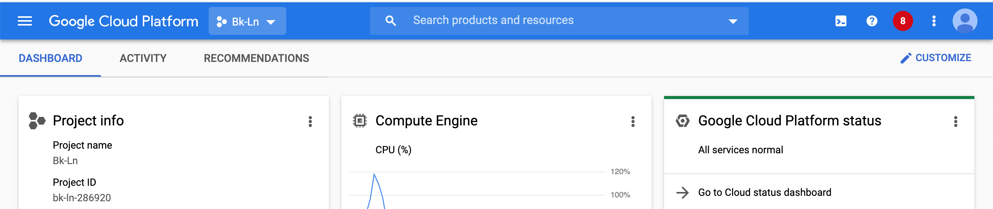


Navigate to Google Cloud Platform and Create New Project

Slide 36
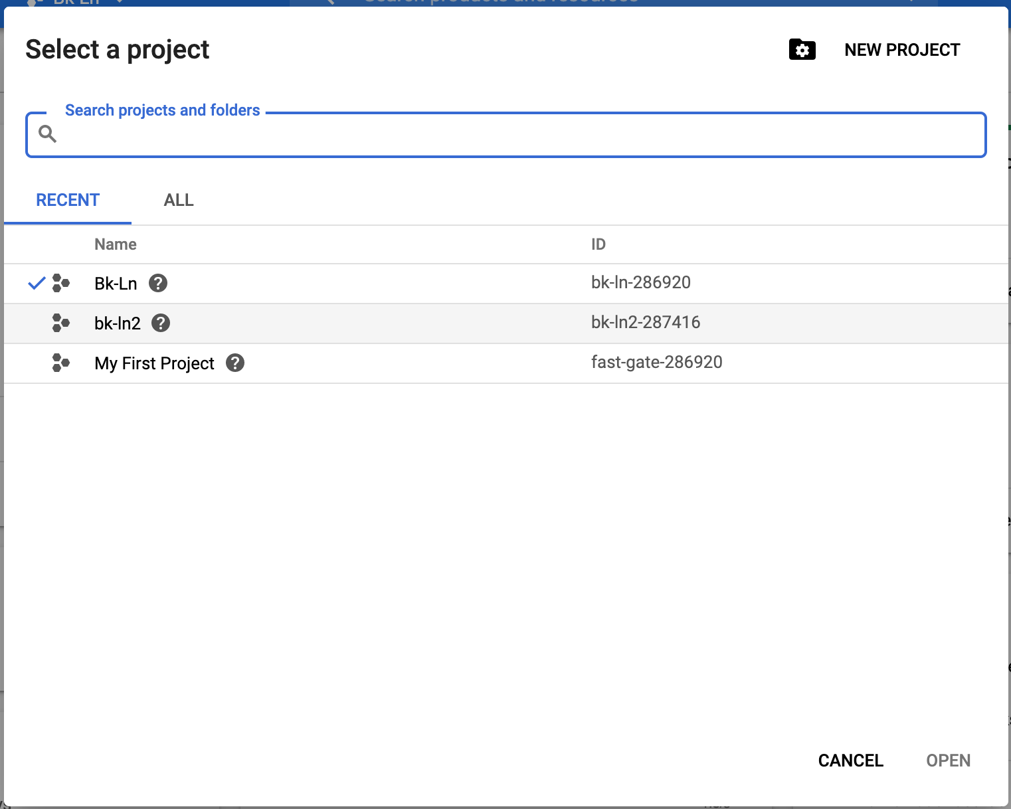

Create New Project

Slide 37
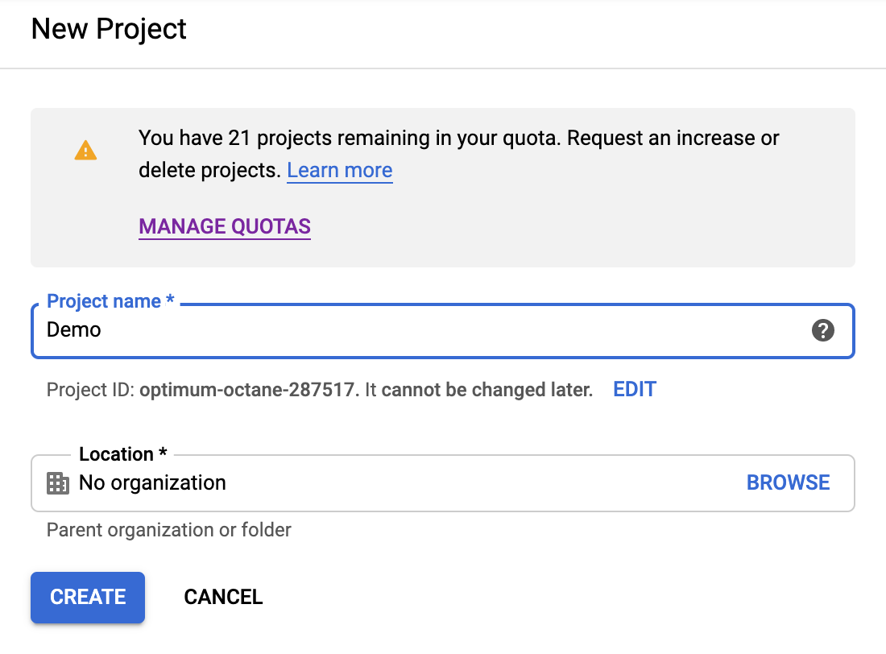
Give Name and press Create

Slide 38
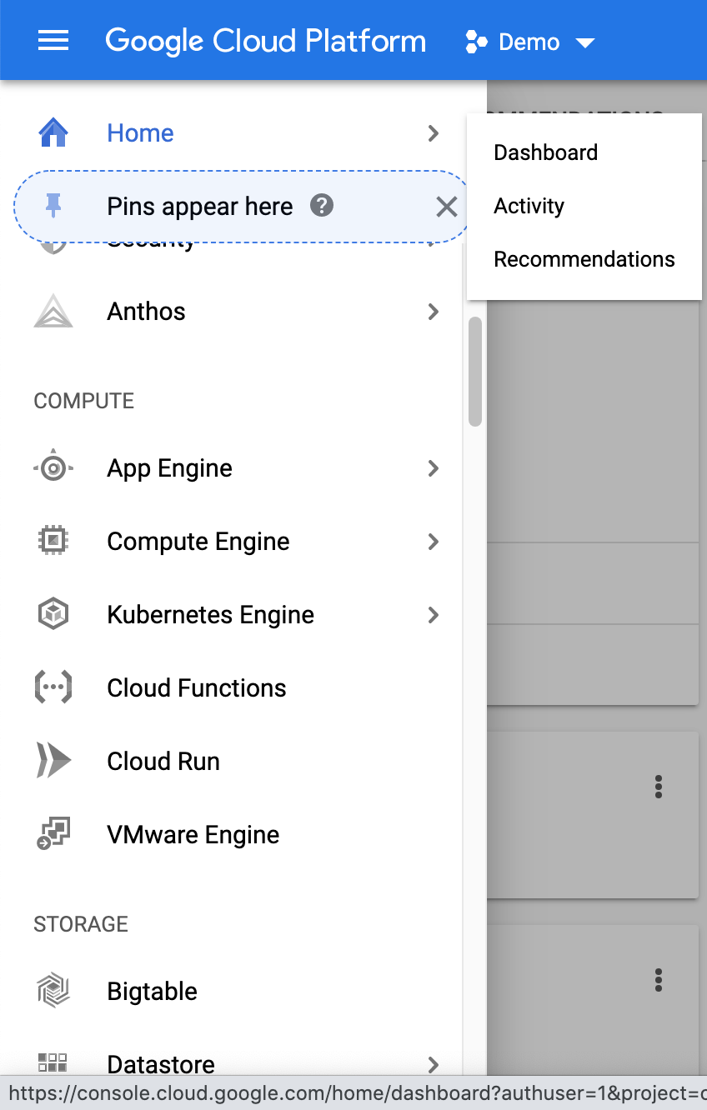

From within the project, use the side menu
(three horizontal lines) to navigate to the
Kubernetes Engine

Slide 39
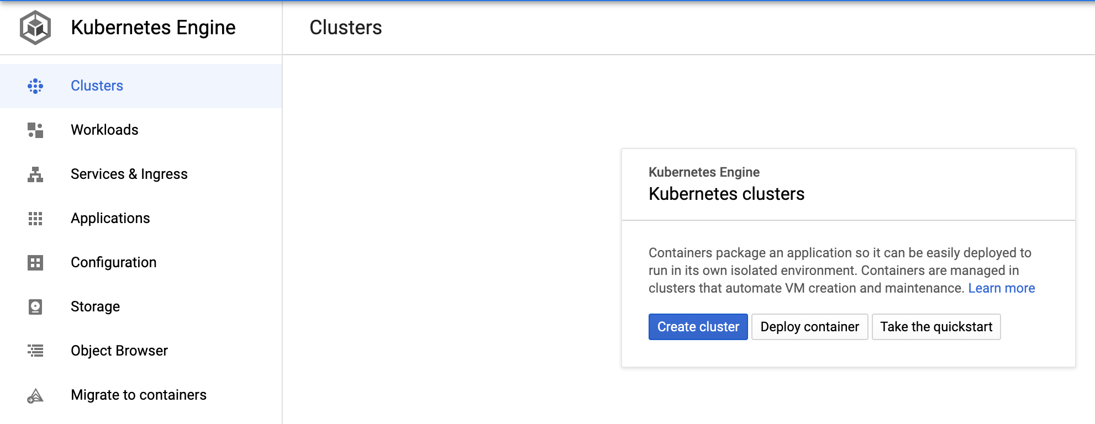
Create a Cluster (you may need to wait a couple of minutes for the Kubernetes Engine API to be enabled)

Slide 40
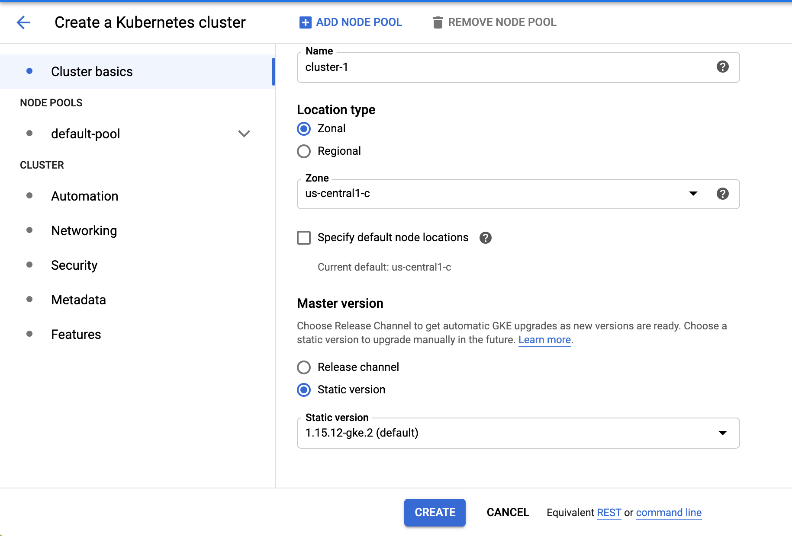
Navigate to the Node-pool settings to set amount of nodes

Slide 41
Nodes - Basic Explanation
In Kuberenetes, Docker containers are deployed to Pods. Pods are deployed to nodes. Nodes are deployed in a cluster. Each node has a certain resource limit which limits the amount of pods that it can house.

Slide 42
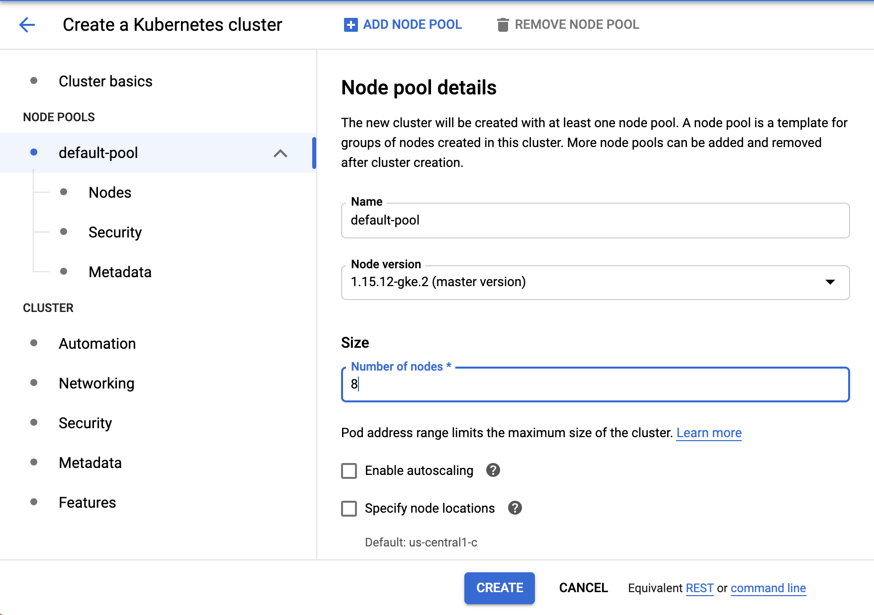
Change number of nodes from 3 to 8 (this is maximum number of nodes allowed without changing the quotas) and click “CREATE”

Slide 43
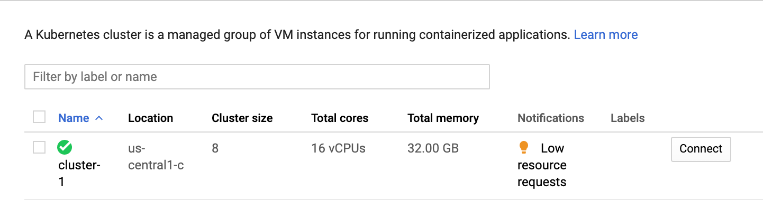
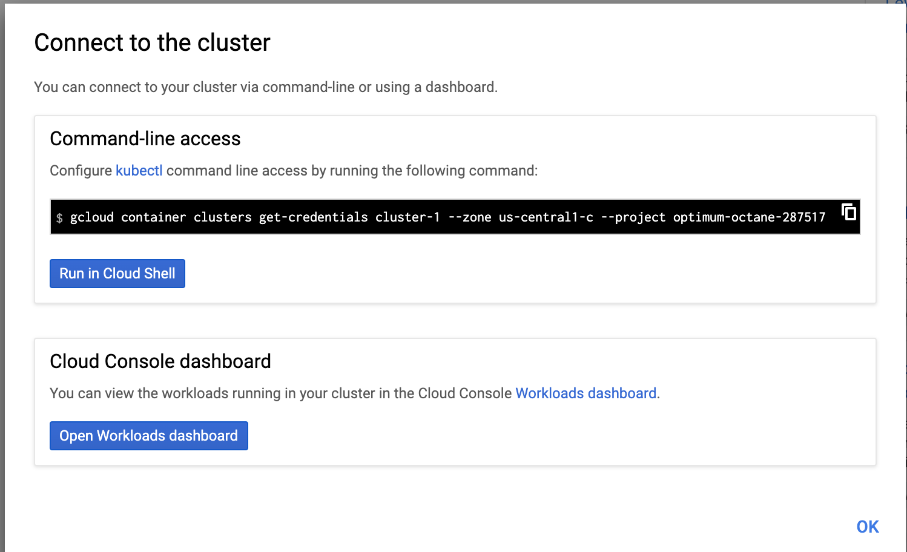

Connect your terminal to the Cluster

Slide 44
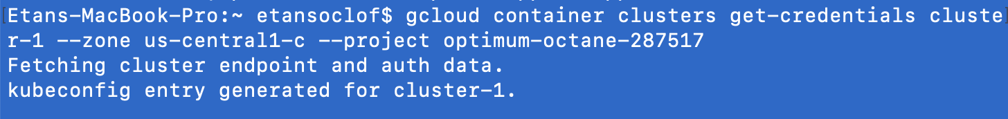
Now kubectl is connected to the GKE cluster

Slide 45
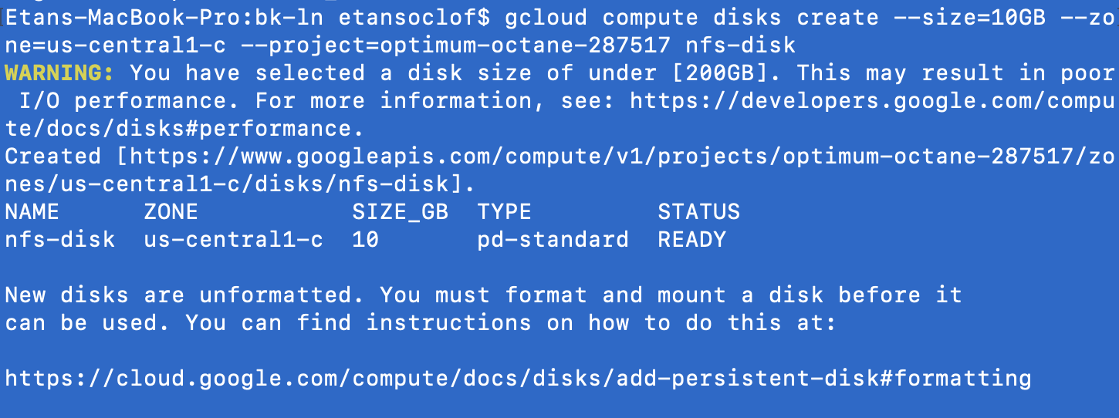
Creating a Shared Directory (a bit complicated on GKE) (https://medium.com/@Sushil_Kumar/readwritemany-persistent-volumes-in-google-kubernetes-engine-a0b93e203180)
Provision a GKE Persistent Disk by running the following command in terminal – this serves as a storage disk
gcloud compute disks create --size=10GB --zone=us-central1-c --project=optimum-octane-287517 nfs-disk
(replace project with appropriate project name)

Slide 46
Setup a NFS Server in GKE
Navigate to bk-ln directory on local computer and run following command:
kubectl create -f nfs-server-deployment.yaml
This creates an nfs server which gives access to the persistent disk

Slide 47
Make NFS Server Accessible
Deploy a service that provides access to the nfs-server deployment
kubectl create -f nfs-clusterip-service.yaml

Slide 48
Create Persistent Volume and Persistent Volume Claim
A Persistent volume is essentially a persistent directory that can be mounted onto a pod. A Persistent Volume Claim is an abstract reference to a Persistent Volume
Kubectl apply –f nfs-pvc.yaml

Slide 49
Deploy the bk and ln deployments
Kubectl apply –f bk-ln-nfs-pvc.yaml

Slide 50
Bk deployment
kind: Deployment apiVersion: apps/v1 metadata: name: bk namespace: default labels: app: bk spec: replicas: 1 selector: matchLabels: app: bk template: metadata: labels: app: bk spec: containers: - name: bk image: 'etansoclof/bk:1200_requests_prediction_count_nMal' resources: limits: cpu: 200m memory: 300Mi requests: cpu: 100m memory: 250Mi command: ['sh', '-c', 'python2 -u te.py ; sleep 3600'] ports: - containerPort: 5000 protocol: TCP volumeMounts: - name: nfs-pvc mountPath: /notebooks/shared volumes: - name: nfs-pvc persistentVolumeClaim: claimName: nfs-pvc restartPolicy: Always

Slide 51
Bk Deployment Breakdown
spec: containers: - name: bk image: 'etansoclof/bk:1200_requests_prediction_count_nMal' resources: limits: cpu: 200m memory: 300Mi requests: cpu: 100m memory: 250Mi

Slide 52
Bk breakdown (cont.)
When the container is started, the above commands will be made in the container. The command “python2 –u te.py” starts the te.py code and prints out the logs.
command: ['sh', '-c', 'python2 -u te.py ; sleep 3600']

Slide 53
Bk breakdown (cont.)
volumeMounts: - name: nfs-pvc mountPath: /notebooks/shared volumes: - name: nfs-pvc persistentVolumeClaim: claimName: nfs-pvc
The persistent volume is referenced and mounted to the “shared” directory in the container

Slide 54
Ln Deployment
kind: Deployment apiVersion: apps/v1 metadata: name: ln namespace: default labels: app: ln spec: replicas: 1 selector: matchLabels: app: ln template: metadata: labels: app: ln spec: containers: - name: ln image: 'etansoclof/ln:1_line_count_nMal_print_6000_17000_bug_fix2_flush_print_request_count_loop' command: - sh - '-c' - python3 -u tmp/data-sender.py volumeMounts: - name: nfs-pvc mountPath: /tmp/shared volumes: - name: nfs-pvc persistentVolumeClaim: claimName: nfs-pvc restartPolicy: Always

Slide 55
Ln Service
This service provides access to the ln pods. Whenever a pod wishes to communite with an ln pod, it does so through the ln service. For instance, in the te.py code, a bk pod sends a get request to the ln pod to get a packet. Because there is a service associated with the ln deployment, this request is made in the following manner:
requests.get('http://ln.default:80')
apiVersion: v1 kind: Service metadata: name: ln spec: selector: app: ln ports: - protocol: TCP port: 80 targetPort: 5000

Slide 56
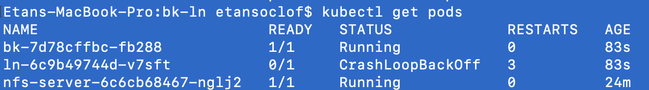

Populating the Persistent Volume
At first, the ln deployment will fail to run. This is because the Persistent volume is not populated. To populate the PV, find the name of the bk pod

Slide 57
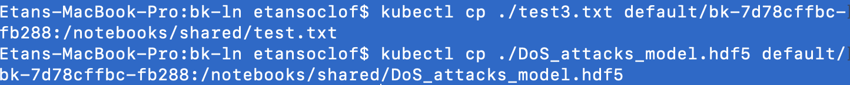
Copy From local computer to Persistent volume
The first command copies the test.txt file to the shared directory.
The second command copies the hdf5 file to the shared directory.

Slide 58
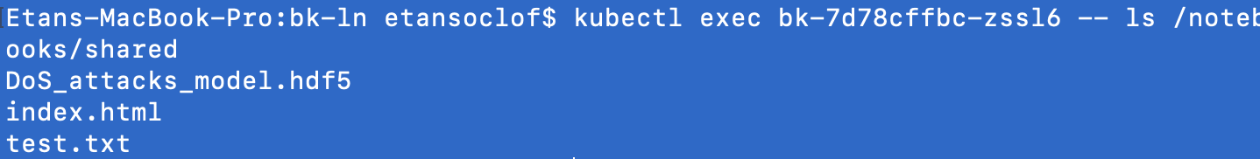
Execute into the pod to check that the files have been copied
kubectl exec bk-7d78cffbc-zssl6 -- ls /notebooks/shared

Slide 59
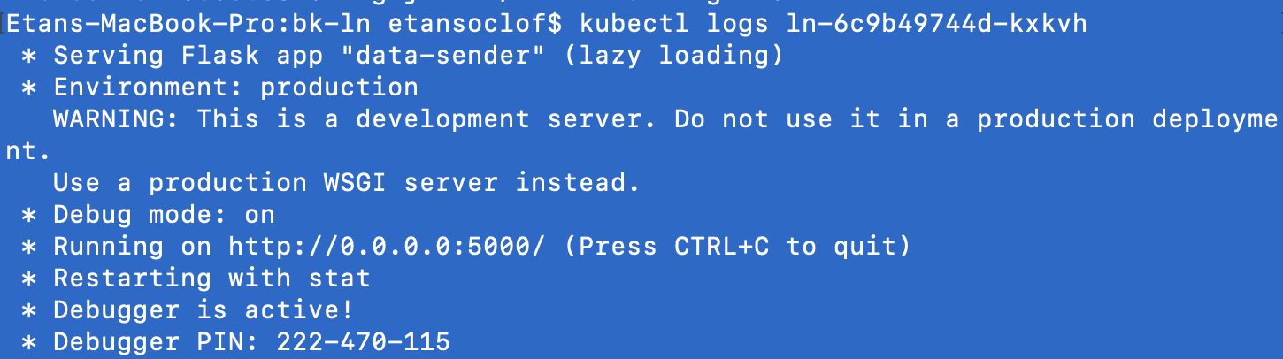
Check logs to ensure everything is running properly
Ln log

Slide 60
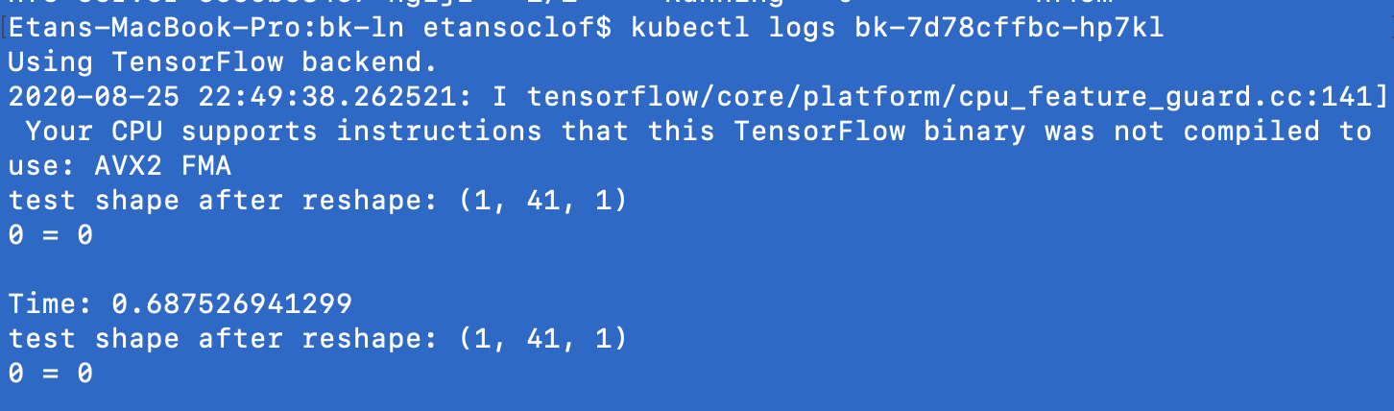
Bk log

Slide 61
Inside bk – te.py
from keras.models import load_model import numpy as np import pandas as pd from sklearn.preprocessing import LabelEncoder from sklearn.model_selection import train_test_split from sklearn.preprocessing import Normalizer from keras.models import Sequential from keras.layers import Dense, Dropout, Flatten, Activation, Lambda from keras.layers import Conv1D, MaxPooling1D, BatchNormalization from keras.layers.noise import GaussianNoise from keras import callbacks from keras.callbacks import CSVLogger from keras.utils import to_categorical from keras.callbacks import ModelCheckpoint, EarlyStopping, ReduceLROnPlateau, CSVLogger import pandas as pd import numpy as np from sklearn.preprocessing import LabelEncoder from sklearn.model_selection import train_test_split from sklearn.preprocessing import Normalizer import warnings warnings.filterwarnings("ignore") from keras.utils import to_categorical from keras.utils import np_utils from keras.models import Sequential from keras.layers import Dense, Dropout, Input,Activation from keras.layers import LSTM,SimpleRNN from keras import optimizers from keras.layers import Flatten from keras import metrics from io import StringIO import timeit import argparse import requests model = load_model('shared/DoS_attacks_model.hdf5') count = 0 timer = timeit.default_timer() while count <= 1200: start = timeit.default_timer() r = requests.get('http://ln.default:80') test = pd.read_csv(StringIO(r.text), header=None) # add target column # normal: 0 else: 1 test['target'] = test.iloc[:,41].apply(lambda x: 0 if x == 'normal' else 1) test.drop(columns=[41,42], inplace=True) categorical = [1,2,3] # categorical data # A LabelEncoder is fit on the train data encoder = LabelEncoder() for col in categorical: test.iloc[:,col] = pd.Series(encoder.fit_transform(test.iloc[:,col])) X_test = test.drop(columns='target',axis=1) y_test = test.target y_test = np.array(y_test) X_test = np.array(X_test) X_test = np.reshape(X_test, (X_test.shape[0], X_test.shape[1], 1)) print('test shape after reshape: {}'.format(X_test.shape)) predictions = model.predict_classes(X_test) if y_test[0] == 1: requests.get('http://ln.default:80/count') print(str(predictions[0][0]) + ' = ' + str(y_test[0])) #result = model.evaluate(X_test, y_test, verbose=0) stop = timeit.default_timer() result = "\nTime: " + str(stop-start) print(result) count+=1 #if stop - timer > 10 : #break print(str(stop - timer))

Slide 62
te.py - breakdown
First the model is loaded from the shared directory.
Then the count is set to 0.
A timer is started to check to see how long the entire code takes to run
model = load_model('shared/DoS_attacks_model.hdf5') count = 0 timer = timeit.default_timer()

Slide 63
A While loop is started
It will count to 1200. This means the program will process 1200 packets from ln
while count <= 1200:

Slide 64
Inside the loop
A timer is started to time the amount of time it takes to process a single packet.
A packet is requested from ln and read
start = timeit.default_timer() r = requests.get('http://ln.default:80') test = pd.read_csv(StringIO(r.text), header=None)

Slide 65
Processing (still inside loop)
# add target column # normal: 0 else: 1 test['target'] = test.iloc[:,41].apply(lambda x: 0 if x == 'normal' else 1) test.drop(columns=[41,42], inplace=True) categorical = [1,2,3] # categorical data # A LabelEncoder is fit on the train data encoder = LabelEncoder() for col in categorical: test.iloc[:,col] = pd.Series(encoder.fit_transform(test.iloc[:,col])) X_test = test.drop(columns='target',axis=1) y_test = test.target y_test = np.array(y_test) X_test = np.array(X_test) X_test = np.reshape(X_test, (X_test.shape[0], X_test.shape[1], 1)) print('test shape after reshape: {}'.format(X_test.shape)) predictions = model.predict_classes(X_test) print(str(predictions[0][0]) + ' = ' + str(y_test[0]))
The packet is processed and the prediction and the actual identity is printed out.

Slide 66
Printing out time (still inside loop
The time it takes to process the single packet is printed out
stop = timeit.default_timer() result = "\nTime: " + str(stop-start) print(result) count+=1

Slide 67
If Mal is found… (still inside loop)
If the packet is malicious, another request is sent to ln to notify it.
if y_test[0] == 1: requests.get('http://ln.default:80/count')

Slide 68
Printing total time (outside of loop)
Once the loop is complete, the duration of the entire program is printed out
print(str(stop - timer))

Slide 69
Inside ln – tmp/data-sender.py
from flask import Flask, request app = Flask(__name__) global count count = -1 global nMal nMal = 0 global hold_lines hold_lines = [] my_file = 'tmp/shared/test.txt' with open(my_file,'r') as text_file: for row in text_file: hold_lines.append(row) @app.route('/') def file(): global count count+=1 global nMal #if (count*10) + 10 >= len(hold_lines) : #count = 0 local_count = count #string = "" #for x in range(local_count, local_count+10): #string += hold_lines[x] print(str(local_count), flush=True) if local_count == 6000: print("N_killed = " + str(nMal), "nMal = " + str(8-nMal), flush=True) if local_count == 17000: print("N_killed = " + str(nMal), "nMal = " + str(8-nMal), flush=True) if count >= len(hold_lines): count = 12000 return hold_lines[local_count] @app.route('/count') def counter(): global nMal nMal = nMal + 1 return "counted" if __name__ == '__main__': app.run(host= '0.0.0.0',debug=True,threaded=True)
A Flask app that sends packets to bk when
requested.

Slide 70
First read test.txt into an array
global hold_lines hold_lines = [] my_file = 'tmp/shared/test.txt' with open(my_file,'r') as text_file: for row in text_file: hold_lines.append(row)

Slide 71
Sending packer
When this function is called (by bk) a packet is sent. The function keeps track of how many packets have been sent. After 6000 and 17000 packets, it prints out the amount of Mal killed.
(Because there is a limited amount of packets, when ln has sent all of its packets, it goes back to packet number 12000 and continues sending packets from there)
@app.route('/') def file(): global count count+=1 global nMal #if (count*10) + 10 >= len(hold_lines) : #count = 0 local_count = count #string = "" #for x in range(local_count, local_count+10): #string += hold_lines[x] print(str(local_count), flush=True) if local_count == 6000: print("N_killed = " + str(nMal), "nMal = " + str(8-nMal), flush=True) if local_count == 17000: print("N_killed = " + str(nMal), "nMal = " + str(8-nMal), flush=True) if count >= len(hold_lines): count = 12000 return hold_lines[local_count]

Slide 72
Counting Mal
This function is called by a bk when a Mal packet has been found. It counts the amount of malicious packets.
@app.route('/count') def counter(): global nMal nMal = nMal + 1 return "counted"

Slide 73
File shuffler
For efficiency, there is a file shuffler located on the local computer called find_normal_and _neptune_packets_and_shuffle.py
It takes the normal and Neptune packets from the test.txt file and shuffles them together.
After shuffling on local computer, copy to GKE using:
kubectl cp test3.txt default/bk-7d78cffbc-hp7kl:/notebooks/shared/test.txt
my_file = 'test.txt' normal = [] neptune = [] count = 0 with open(my_file,'r') as text_file: for row in text_file : if "normal" in row: normal.append(row) if "neptune" in row: neptune.append(row) with open("test2.txt",'w') as next_file: for normal_row in normal: next_file.write(normal_row) count+=1 if count == 10000: count2 = 0 for neptune_row in neptune: next_file.write(neptune_row) count2 += 1 if count2 >= 83: break import random first = [] second = [] count = 0 with open("test2.txt",'r') as text_file: for row in text_file : if count <= 10083: first.append(row) count+=1 else: second.append(row) random.shuffle(first) random.shuffle(second) with open("test3.txt",'w') as next_file: for row in first: next_file.write(row) for row in second: next_file.write(row)

Slide 74
Scaler.py
The scaler.py is on the local computer. See slides 1-7 on how scaling using the Kubernetes python client work.

Slide 75
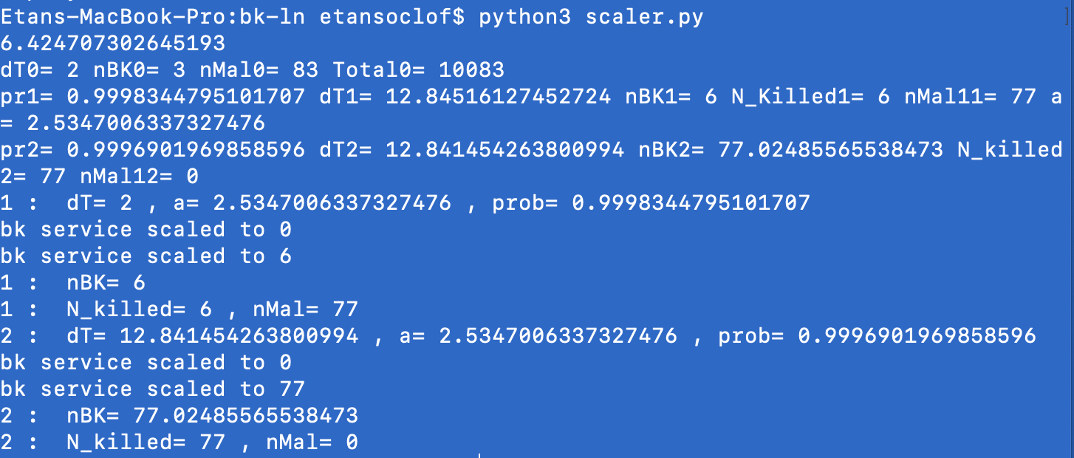
In the first stage, it scales to 6. In the second stage, it scales to 77.

Slide 76
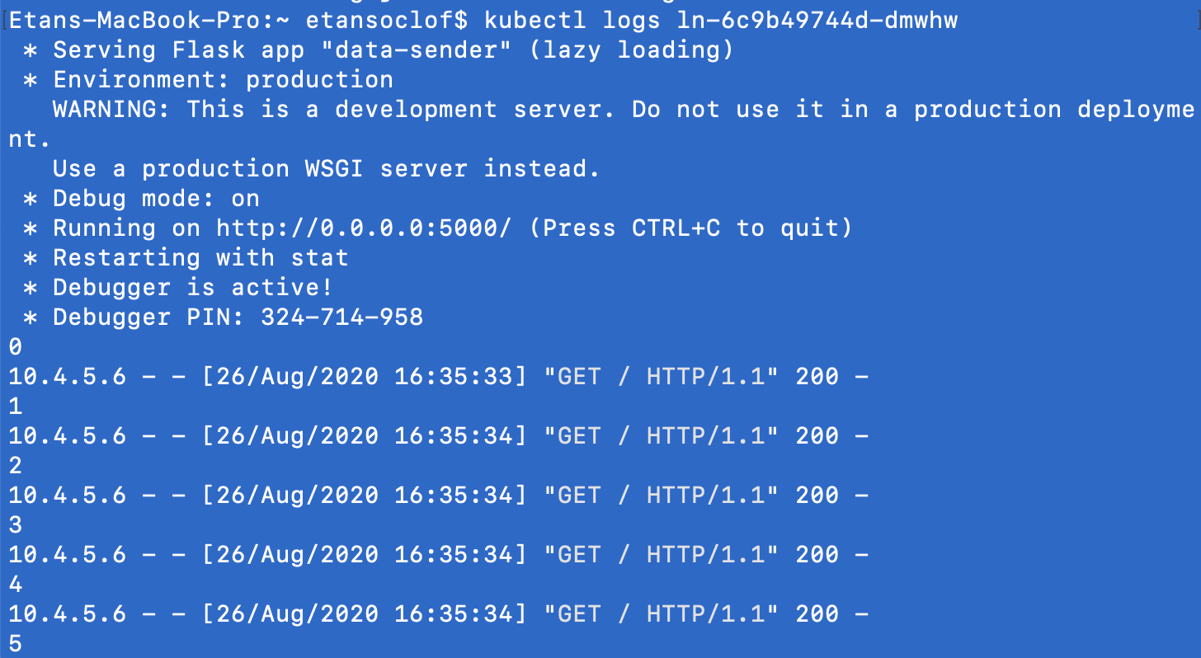
Checking the logs
You can check the logs of the ln pod to see the requests being made.

Slide 77
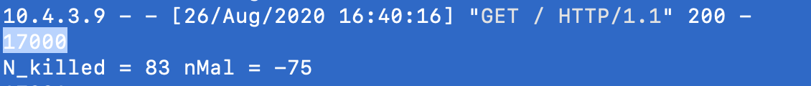
nMal
In the ln logs, after 6000 and 17000 packets have been sent, the amount of Malicious packets that have been
found is printed out

